Slide 1
v
Reflect – Why you want Change
Define your goals
Declutter
Reorganise
Maintain
Beautify

Slide 2
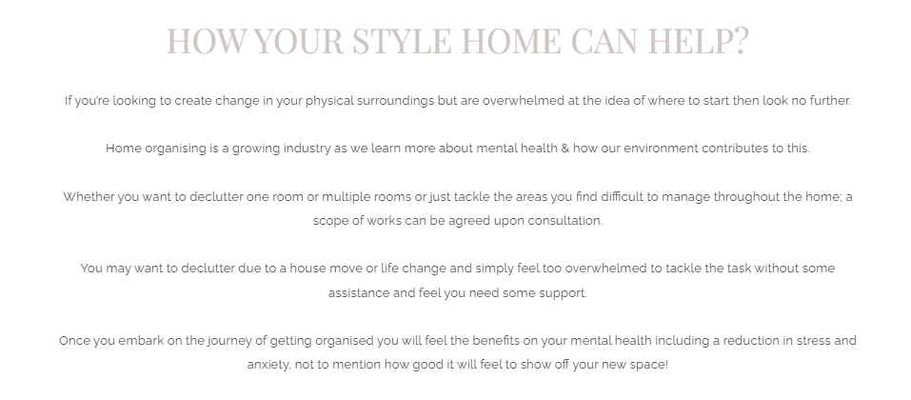

Slide 3
If you’re looking to create change in your physical surroundings but are overwhelmed at the idea of where to start then look no further.
Home organising is a growing industry as we learn more about mental health & how our environment contributes to this.
Whether you want to declutter one room or multiple rooms or just tackle the areas you find difficult to manage throughout the home; a scope of works can be agreed upon consultation.
You may want to declutter due to a house move or life change and simply feel too overwhelmed to tackle the task without some assistance and feel you need some support.
​Once you embark on the journey of getting organised you will feel the benefits on your mental health including a reduction in stress and anxiety, not to mention how good it will feel to show off your new space!

