Slide 1
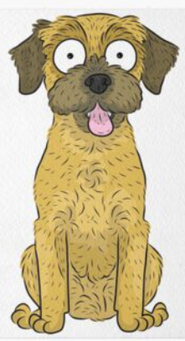
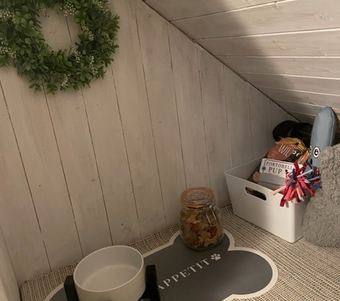
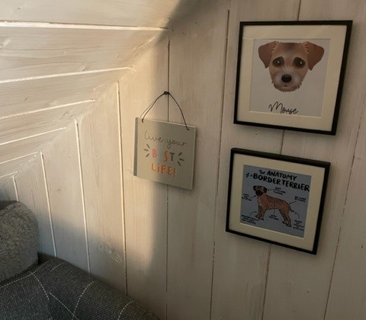
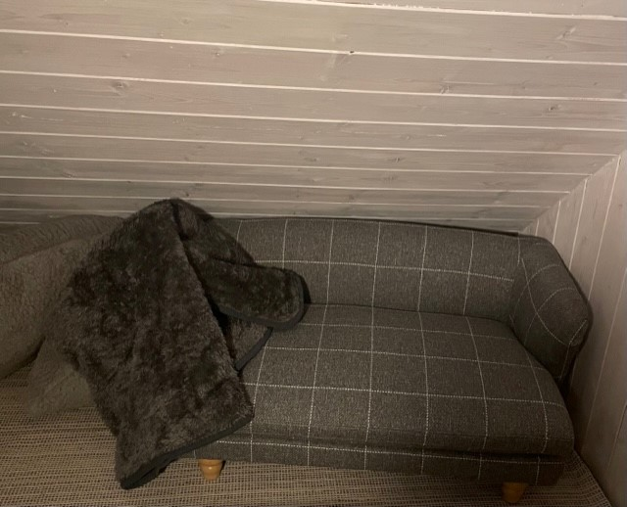
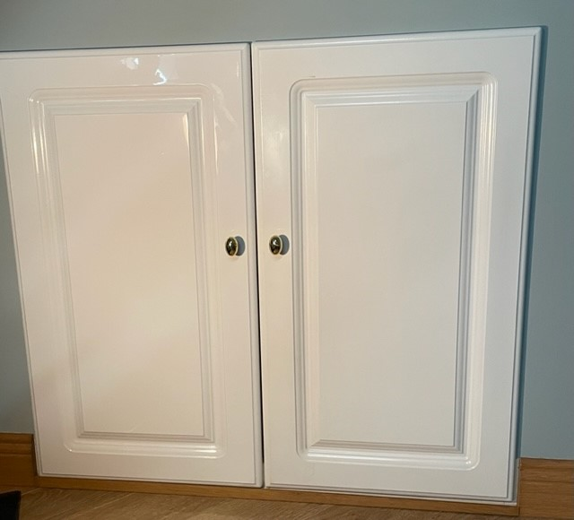
Mouse House:
So this is a little project that I did in my own home as I needed to create a little safe space for my new dog Mouse. It was a cupboard that was used for storage but after a quick declutter, clear and a paint job I have made this into a deluxe doggy den.

